Slide 1
Intern Project Report Prepared by: Wenjie Wang Date: 10/05/2024

Slide 2
Use Case and Problem Statement
What problems should this project solve for the clients?
This project aims to automate the process of handling and loading data into the Snowflake database, specifically by reading files from Google Cloud Storage (GCS) and automatically inserting them into Snowflake. The primary challenge is to ensure a seamless integration between GCS, Snowflake, and automated workflows using GitHub Actions and Google Cloud Functions.
This solution helps the client streamline data processing tasks, reducing the need for manual interventions and improving the efficiency of data uploads and synchronization. By automating the workflow, the project ensures data accuracy and timely updates within the Snowflake database.

Slide 3
Scope and Objective
Project Scope
This project involves the use of GCP's Cloud Functions, Snowflake for data management, and GitHub for automated deployment and file synchronization.
Project Objective
Establish an automated process to load files uploaded to GCS into the Snowflake database, with automated deployment and triggering managed through GitHub Actions.

Slide 4
Engineering Design
load-data-to-snowflake-function:
Cloud Run Functions Design：
load-data-to-snowflake-function
This function is triggered whenever a YAML file is uploaded to a specified GCS bucket. The function downloads the file, extracts its content, and dynamically creates a Snowflake table based on the YAML data structure. The data is then inserted into the Snowflake table.
actual_data_uploaded
This function is triggered by CSV file uploads to a second GCS bucket. It processes the CSV file and loads the data into two Snowflake tables: a staging table and a raw data table. The staging table temporarily holds the data, and based on the configuration, it either merges or inserts the data into the raw table.

Slide 5
Engineering Design
load-data-to-snowflake-function:
A GitHub workflow (workflows/main.yml) is triggered whenever changes are pushed to the main branch. This workflow performs several actions:
Data Processing Workflow & Data Insertion:
YAML Files:
Extract schema and data fields from the YAML file.
Create or update the Snowflake table based on the extracted data.
For YAML data, the schema is used to generate tables dynamically in Snowflake.
CSV Files:
Read the CSV content, extract column headers.
Load the data into staging and raw tables in Snowflake.
For CSV data, the pipeline processes raw and staged data, inserting and merging into the appropriate tables in Snowflake.

Slide 6
Software Tools
Google Cloud Platform (GCP)
Github
Snowflake
Excel

Slide 7
Module Description
load-data-to-snowflake-function
Cloud Event Trigger
Snowflake Connection Setup
Schema Creation
Downloading File from GCS
Dynamic Table Creation
Data Insertion and Merge Logic
Finalizing and Committing the Transaction
actual_data_uploaded
Cloud Event Trigger
Snowflake Connection Setup
Loading Table Check
Downloading CSV File from GCS
Table Management
Data Insertion and Merge Logic
Transaction Commit and Cleanup
Notes:
Below is a detailed description of each function, explaining their purpose, key modules, and the main steps involved in their execution.
load-data-to-snowflake-function: This function is designed to handle YAML configuration files uploaded to Google Cloud Storage (GCS). It processes these files by reading the contents, creating the necessary schema and tables in Snowflake, and then loading the data into the database. The function has several important modules:
Cloud Event Trigger: The function is triggered when a YAML file is uploaded to a specific GCS bucket. The event provides metadata about the uploaded file, such as the bucket and file name.
Snowflake Connection Setup: The function begins by establishing a connection to the Snowflake database using environment variables for credentials such as SNOWFLAKE_USER, SNOWFLAKE_PASSWORD, and SNOWFLAKE_ACCOUNT. This ensures secure and authenticated access to the database.
Schema Creation: Once connected to Snowflake, the function checks if the required schema exists. If it does not, the function dynamically creates the schema. This is important for organizing the data in the Snowflake database.
Downloading File from GCS: The function retrieves the YAML file from the GCS bucket, downloads the content, and parses it using the PyYAML library. This is a key step, as the file content will define the structure of the data to be inserted into Snowflake.
Dynamic Table Creation: Using the parsed YAML data, the function dynamically constructs a SQL query to create the Snowflake table. The table columns are defined based on the keys present in the YAML file, and the table is created if it doesn’t already exist.
Inserting Data into Snowflake: After creating the table, the function inserts the parsed YAML data into the Snowflake table. It generates the appropriate SQL INSERT query, and the data is added to the designated loading table.
Finalizing and Committing the Transaction: The function commits the transaction to ensure all changes are saved and closes the connection to Snowflake. This completes the process of loading the data into Snowflake. actual_data_uploaded: This function is triggered by the upload of CSV files to another GCS bucket. Its main purpose is to process the CSV file, load it into both a staging and a raw data table in Snowflake, and manage data flow between the two. The core modules of this function are as follows:
Cloud Event Trigger: Similar to the first function, this one is triggered by a cloud event when a CSV file is uploaded to the designated GCS bucket. The file’s name and bucket information are extracted from the event metadata.
Snowflake Connection Setup: The function connects to Snowflake using pre-defined credentials (similar to the first function), ensuring access to the correct Snowflake account, warehouse, and database.
Loading Table Check: The function queries a control table (loading_table) in Snowflake to check if there is an existing entry for the uploaded CSV file. This table stores metadata about the files and defines how the data should be processed.
Downloading CSV File from GCS: The function retrieves the CSV file from the GCS bucket and reads its content using Python’s csv library. Depending on whether the file has headers, it extracts column names dynamically.
Staging Table Management: The function creates or updates a staging table in Snowflake based on the column names extracted from the CSV file. The table is truncated before new data is inserted to ensure no duplicate entries from previous uploads.
Raw Table Management: The function also checks if a raw data table exists in Snowflake. If it doesn’t, it creates the table. The raw table is meant for storing the full dataset, whereas the staging table temporarily holds incoming data.
Data Insertion and Merge Logic: Depending on the truncate_flag parameter, the function either truncates the raw table and inserts all new data or merges the staging data into the raw table to prevent duplication. The merge logic ensures that existing records are updated, while new records are inserted.
Transaction Commit and Cleanup: After inserting or merging the data, the function commits the transaction and closes the connection to Snowflake, ensuring that all changes are saved. This marks the successful completion of the data loading process.

Slide 8
Future Scope
Support for More File Formats
Data Cleaning and Preprocessing
Enhanced Security and Access Control
Automated Report Generation
Notes:
Support for More File Formats:
Currently, the project mainly processes YAML and CSV files. In the future, it could be expanded to support additional file formats such as JSON, XML, or Parquet. This would allow the system to handle more diverse data sources.
Data Cleaning and Preprocessing:
At present, the data is loaded into Snowflake directly after being uploaded to GCS. A future enhancement could introduce automated data cleaning steps before loading, such as removing duplicates, handling missing values, and standardizing data formats. This would ensure higher data quality before it is inserted into the database.
Enhanced Security and Access Control:
As the volume and sensitivity of data increase, the project could strengthen its access control mechanisms, ensuring that only authorized users can access and modify the data. Encryption can also be added to protect the data during upload, storage, and processing, ensuring its security.
Automated Report Generation:
In the future, the project could include a feature to automatically generate reports after data processing is complete, providing summaries of the results and sending them to relevant users. This would help users quickly understand the status and outcome of data processing tasks.

Slide 9
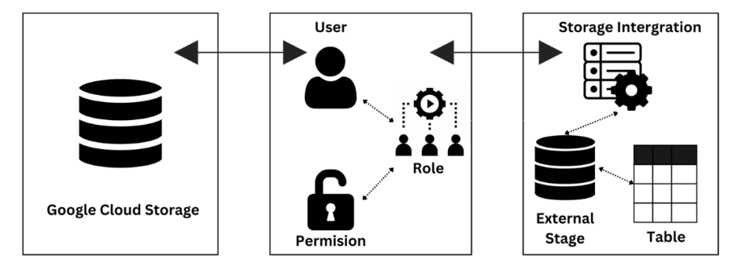
Data Flow Diagram
Google Cloud Platform
Google Cloud IAM
Snowflake

Slide 10
Test and Verification
customer1.csv
Objective:
To ensure the correct handling of customer data, where each record from the CSV is uploaded to Google Cloud Storage (GCS) and processed by the function.
Verification:
Verify that the customer data from customer1.csv was correctly inserted into both the staging table and the raw table. All records were correctly processed, with no errors or duplicates observed.
customer3.csv
Objective:
To confirm the function's ability to handle additional customer data and ensure the merging logic works as intended.
Verification:
Verify that the table was successfully created in Snowflake with the correct schema. The data from customer.yml was correctly inserted into the table, matching the expected structure defined in the YAML configuration.

Slide 11
Conclusion
The project successfully automated the processing of YAML and CSV files using Cloud Functions, enabling seamless data loading into Snowflake. Dynamic data management was achieved by automatically creating tables based on file structures, and GitHub Actions facilitated automated file synchronization and function triggering.
This resulted in increased efficiency by reducing manual operations, ensuring data accuracy through incremental updates, and greatly simplifying the overall data upload and processing workflow.
Notes:
Key Achievements
Cloud Functions Automation: Automated processing of YAML and CSV files, enabling data to be loaded into Snowflake automatically.
Dynamic Data Management: Dynamically created tables and inserted data based on file structure.
GitHub Actions for Automation: Achieved file synchronization and triggered functions automatically through GitHub Actions.
Project Value
Increased Efficiency: Automation reduced manual operations, improving data processing speed.
Data Accuracy: Implemented incremental data updates, ensuring consistency and accuracy of data.
Simplified Workflow: The automated workflow greatly simplified the data upload and processing process.

Slide 12
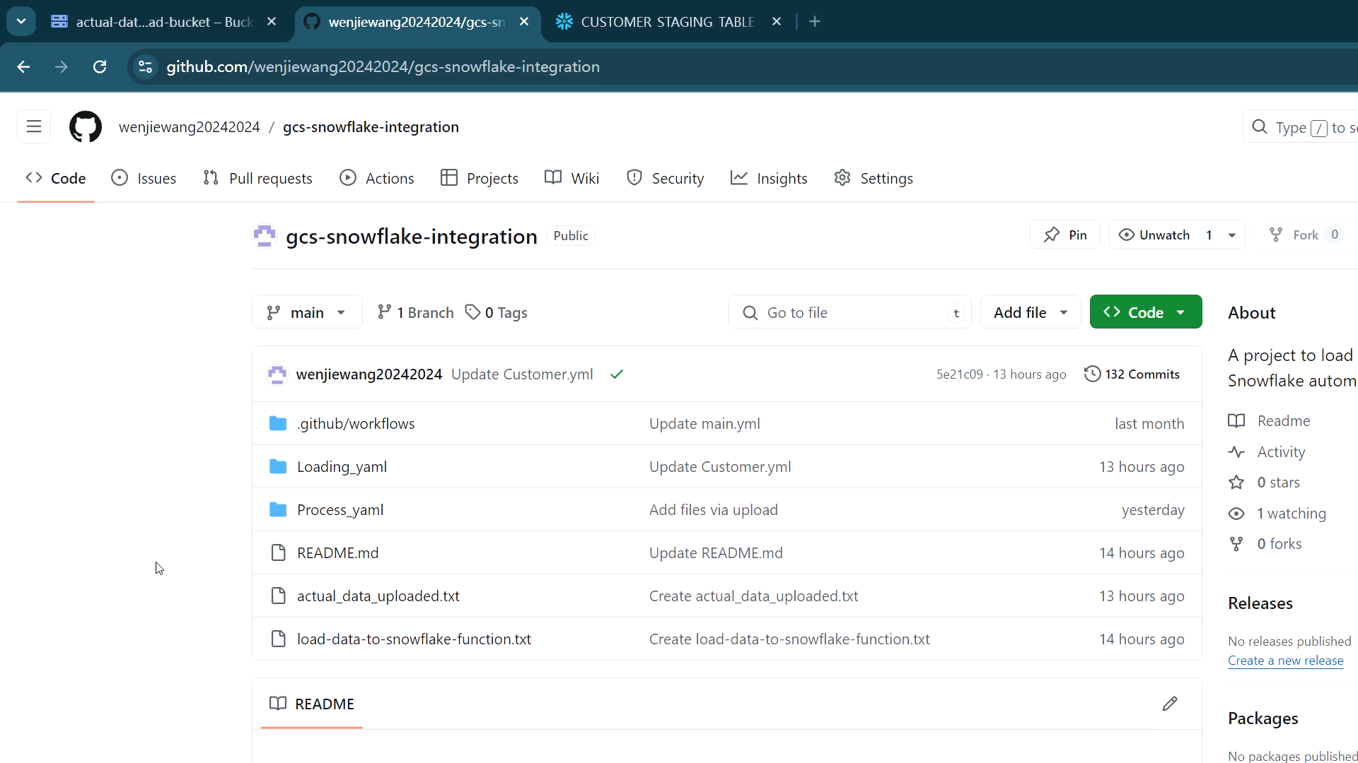
Video

Slide 13
THANKS

